Slide 1
Lesson 2
PL/SQL Overview

Slide 2
Objective
In this lesson we will cover the following :
  Explain the need for PL/SQL
  Explain the benefits of PL/SQL
  Identify the different types of PL/SQL blocks
  Output messages in PL/SQL

Slide 3
Lesson Agenda
  Understanding the benefits and structure of PL/SQL
  Understanding PL/SQL blocks
  Generating output messages in PL/SQL

Slide 4
Limitations of SQL
  Performs one operation at a time on the database
  Lacks the capability of logically grouping multiple database operations
Notes:
Java SE 8 Programming 2 - <number>

Slide 5
Why PL/SQL?
  Enables modularization in the application
  Provides better security
  Enables maintainability
  Provides exception handling

Slide 6
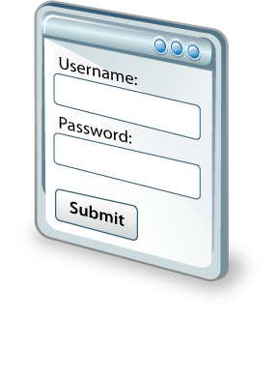











Why PL/SQL
Input parameters from the end-user
Response generated based on the output from the PL/SQL program unit
PL/SQL objects on Database
End-User

Slide 7





About PL/SQL
  Stands for “Procedural Language Extension to SQL”
  Integrates procedural constructs with SQL
  Provides a block structure for executable units of code
  Provides procedural constructs such as:
    Variables, constants, and data types
    Control structures: Loops, conditional statements
  Enables writing reusable program units

Slide 8
Benefits of PL/SQL
  Integration of procedural constructs with SQL
  Improved performance
  Modularized program development
  Integration with Oracle tools
  Portability
  Exception handling
  Support for Object Oriented Programming

Slide 9
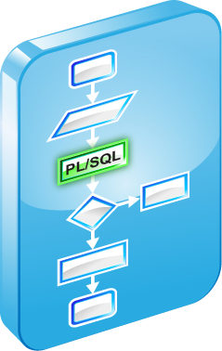











PL/SQL Runtime Architecture
PlSql Engine
Procedural
PlSql
PlSql
PlSql Block
Oracle Server

Slide 10

PL/SQL Block Structure
  DECLARE (optional)
    Variables, cursors, user-defined exceptions
  BEGIN (mandatory)
    SQL statements
    PL/SQL statements
  EXCEPTION (optional)
    Actions to perform when exceptions occur
  END (mandatory)

Slide 11


Block Types
Anonymous blocks
Functions
PL/SQL Blocks
Subprograms
Procedures
Triggers

Slide 12
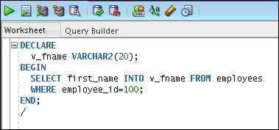
Examining an Anonymous Block
An anonymous block in the SQL Developer workspace:

Slide 13
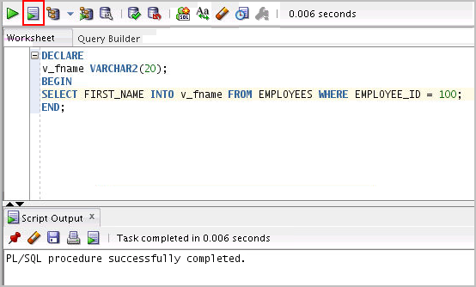
Executing an Anonymous Block
Click the Run Script icon to execute the anonymous block:

Slide 14
Enabling Output of a PL/SQL Block
  To enable output in SQL Developer, execute the following command before running the PL/SQL block:
SET SERVEROUTPUT ON
  Use a predefined Oracle package and its procedure in the anonymous block:
    DBMS_OUTPUT.PUT_LINE
DBMS_OUTPUT.PUT_LINE(' The First Name of the Employee is ' || v_fname);
…..

Slide 15

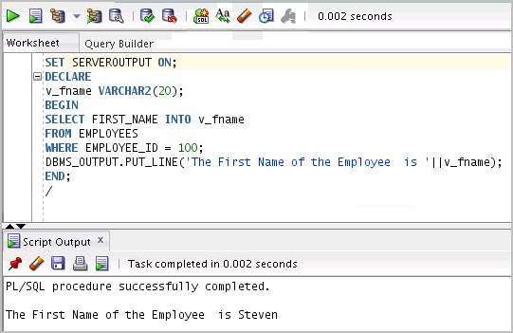
Viewing the Output of a PL/SQL Block
Press F5 to execute the command and PL/SQL block.

Slide 16

Quiz
A PL/SQL block must consist of the following three sections:
  A Declarative section, which begins with the keyword DECLARE and ends when the executable section starts
  An Executable section, which begins with the keyword BEGIN and ends with END
  An Exception handling section, which begins with the keyword EXCEPTION and is nested within the executable section

Slide 17
Summary
In this lesson, you should have learned how to:
  Explain the need for PL/SQL
  Explain the benefits of PL/SQL
  Identify the different types of PL/SQL blocks
  Output messages in PL/SQL

